Slide 1


CAPSTONE PROJECT 3
Sentiment Analysis :
Predicting sentiment of COVID-19 tweets
Team Member : Kritika Sharma

Slide 2
CONTENTS
1- Problem Statement
2- Data Summary
3- Missing Values
4- Exploratory Data Analysis
5- Feature Engineering
6- Model Training
7- Results from Model
8- Challenges
9- Conclusion

Slide 3

PROBLEM STATEMENTS
Coronavirus disease (COVID-19) is an infectious disease caused by the SARS-CoV-2 virus. There is lot of misuse of social media platform, in which Twitter is one of them. Many user intentionally send negative tweets to create fear and negativity in the society or environment.
Our objective is to build a machine learning model to predict the sentiment of COVID-19 tweets. If tweets had been found negative then tweets would be removed from twitter.

Slide 4
DATA SUMMARY
We are using single data set for analysis
Coronavirus_Tweets.csv :- Tweets sentiments during COVID-19 details
DETAILS OF DATA SET PROVIDED
SR.NO. | DATA SET | VARIABLES | NO. OF VARIABLES | NO. OF OBSERVATIONS
1 | Coronavirus_Tweets | Username, Screen Name, Tweet at, Location, Original Tweet , Sentiments | 6 | 41157

Slide 5
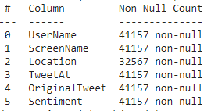
Looking for Missing Values
1- On looking the dataset we found that feature ‘Location’ has missing values.
2- We don’t have any idea about that tweets whose location is missing.
3- So we have ap option to fill that missing values by Mode or another way is to fill randomly.
4- Also, one way is to drop those columns to get rid off missing values.

Slide 6

Exploratory Data Analysis

Slide 7
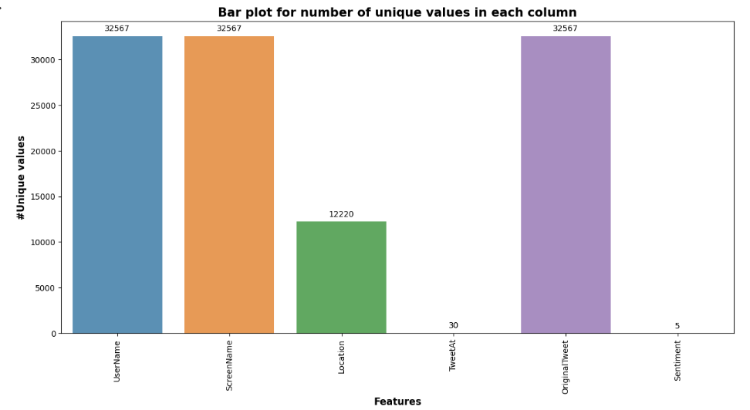
Number of Unique features

Slide 8
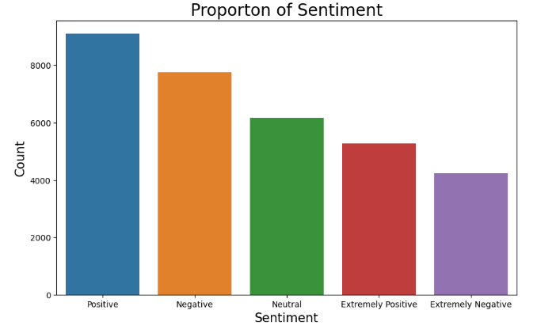
Sentiment Count

Slide 9
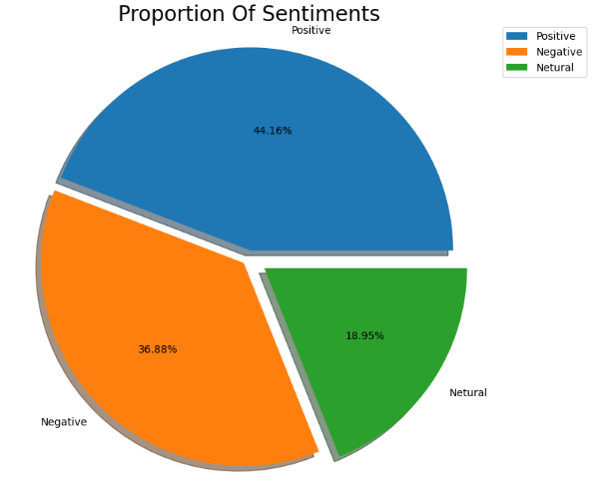
Proportion of Sentiments

Slide 10
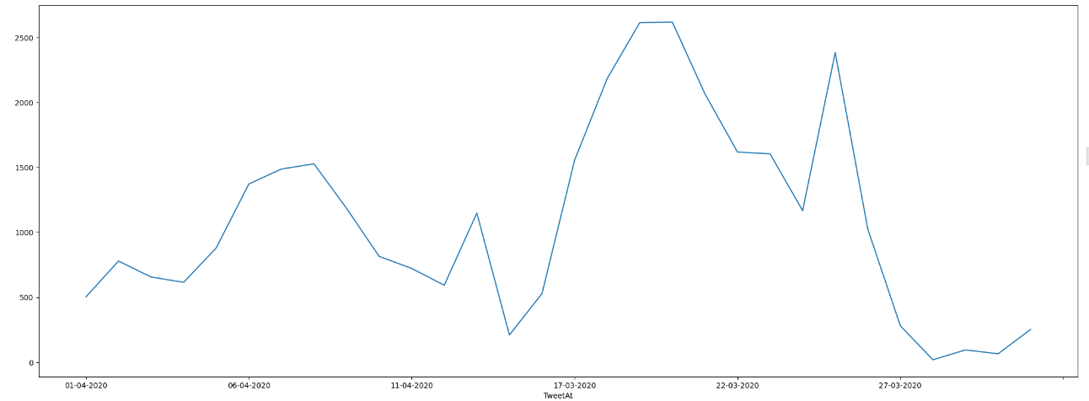
Plot between Number of Tweets and TweetAt

Slide 11
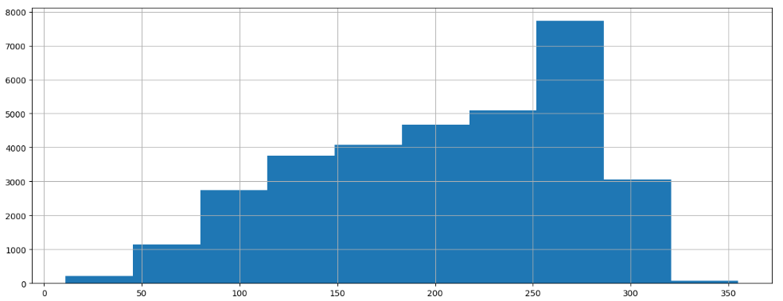
Number of Tweets according to the length

Slide 12
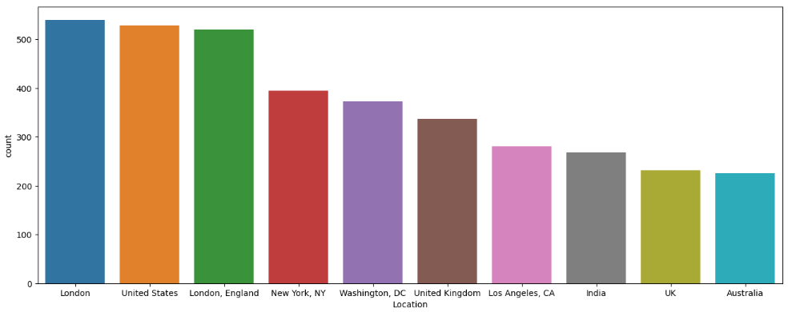
Tweets from Top 10 Location

Slide 13

Feature Engineering

Slide 14

Word Cloud

Slide 15

Common words used in the tweets with respect to Positive Sentiment

Slide 16
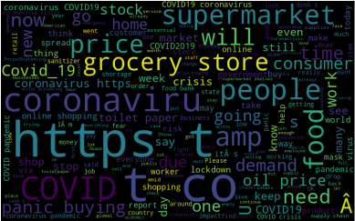
Common words used in the tweets with respect to Negative Sentiment

Slide 17
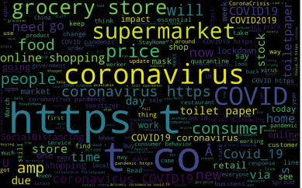
Common words used in the tweets with respect to Neutral Sentiment

Slide 18
Sentiment Analysis
1- There are 5 different sentiments are present in dataset.
1. Neutral
2. Positive
3. Extremely Positive
4. Negative
5. Extremely Negative
2- To make problem simpler we changed the sentiments into 3 different types.
3- We merged Extremely positive and Positive into one and Extremely Negative and Negative into another.
1. Neutral
2. Positive
3. Negative

Slide 19
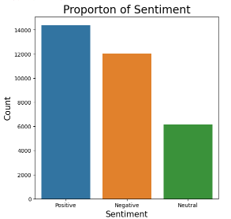
Sentiments Count plot

Slide 20
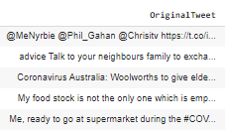
Data Cleaning
1- By looking tweets we can found that there are lots of punctuation, Stopwords and Special Characters.
2- So, we need to remove the from our Original Tweet as they won’t play any major role in Sentiment analysis.

Slide 21
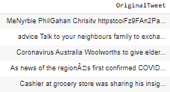
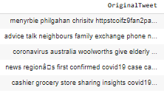
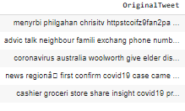
Data Cleaning
STEP 1 : Remove punctuations.
The marks, such as full stop, comma, and brackets, used in writing to separate sentences and their elements and to clarify meaning.
STEP 2 : Remove Stopwords. (Stopwords are the English words which does not add much meaning to a sentence. For example, the words like the, he, have etc.).
STEP 3 : Apply Stemming.
(Stemming is basically removing the suffix from a word and reduce it to its root word sentence.

Slide 22

Model Formulation

Slide 23
Model Formulation
S.No | Model | Dataset Shape | Algorithm Used
1 | Independent Feature – ‘OriginalTweet’ Dependent feature – ‘Sentiment’ | (32567,6) | Logistic Regression Passive Aggressive Classifier, Stochastic Gradient Descent Classifier, Support Vector machine Random Forest

Slide 24
Model Output Comparison
S.No | Alogrithm Used | Accuracy | Precision | Recall
01 | Logistic Regression | 0.7752 | 0.7887 | 0.7752
02 | Passive Aggressive Classifier | 0.7396 | 0.7474 | 0.7396
03 | Stochastic Gradient Descent Classifier | 0.7692 | 0.8050 | 0.7692
04 | Support Vector machine | 0.7692 | 0.8050 | 0.7692
05 | Random Forest | 0.7359 | 0.7410 | 0.7359

Slide 25

Challenges and Conclusions

Slide 26
Challenges
1. Removing the missing values
2. Cleaning the Original tweets
3. Selection of best model

Slide 27
Conclusion
1. Original Dataset contains 6 columns and 41157 rows.
2. ‘Location’ column contains approx. 21% of Null values.
3. The columns such as “UserName” and “ScreenName” does not give any meaningful insights for our analysis.
4. There are five types of sentiments- Extremely Negative, Negative, Neutral, Positive and Extremely Positive. So, we merged Extremely Positive with positive and Extremely Negative with Negative.
6. All tweets data collected from months March and April 2020
7. Most of the tweets came from London followed by U.S.
8. Our project with 5 models namely Logistic Regression,Random Forest,Stochastic Gradient Descent,SVM and Passive Aggressive Classifier.We are getting the highest accuracy of about 78% with Logistic Regression.We also tested our best models on some new tweet and the results are fairly accurate.

Slide 28


